Slide 1

Breast Cancer Classification using CNN
EE-4953-901-natural language processing
Fall 2023
Parth Patel
Supervisor Dr. Mario Flores
Electrical & Computer Engineering Department and Department of Educational Psychology

Slide 2
Outlines:
Introduction
Dataset
Research methods
Result
References
Electrical & Computer Engineering Department and Department of Educational Psychology

Slide 3
Introduction
Why Beast Cancer awareness is important?
Average risk for women in the United States: 13%
Represents a 1 in 8 chance of developing breast
it could change body shape, hair loss, early menopause and loss of fertility.
Electrical & Computer Engineering Department and Department of Educational Psychology

Slide 4
Dataset
The original dataset consisted of 162 whole mount slide images of Breast Cancer (BCa) specimens scanned at 40x.
From that, 277,524 patches of size 50 x 50 were extracted (198,738 IDC negative and 78,786 IDC positive).
Electrical & Computer Engineering Department and Department of Educational Psychology
Notes:
Invasive ductal carcinoma

Slide 5
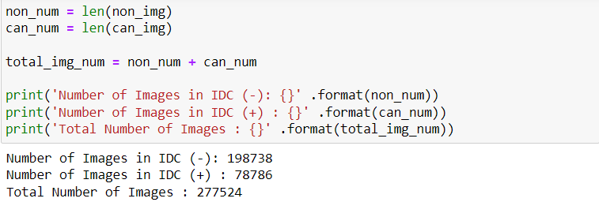
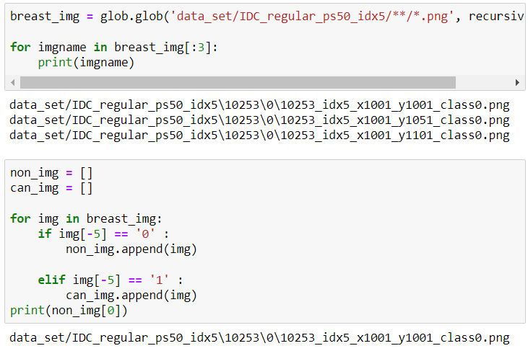
Dataset
Electrical & Computer Engineering Department and Department of Educational Psychology
Notes:
Invasive ductal carcinoma

Slide 6
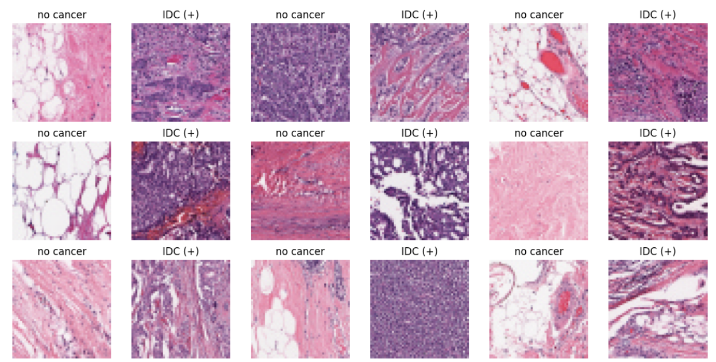
Dataset
Electrical & Computer Engineering Department and Department of Educational Psychology
Notes:
In situ: In the normal location
stage 1 (earliest stage) to a stage IV (most advanced stage)

Slide 7
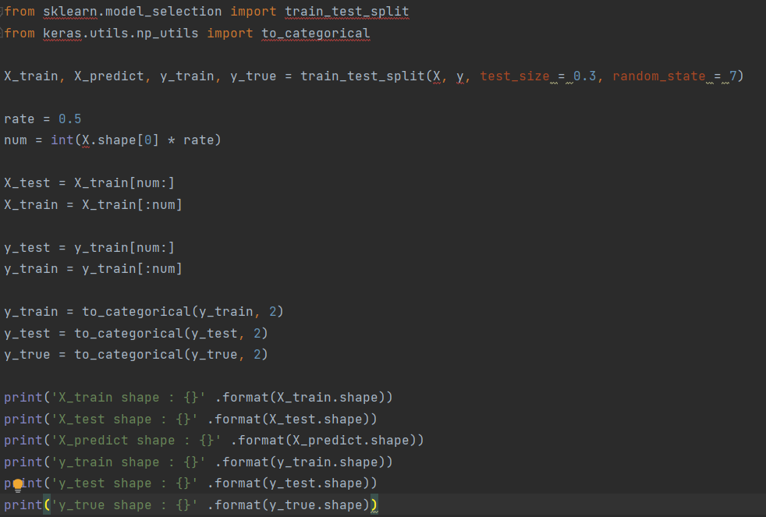
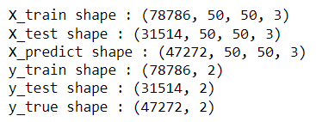
Dataset for Training and Test
Electrical & Computer Engineering Department and Department of Educational Psychology

Slide 8
Research methods
What is the CNN?
CNN is an attempt to mimic human behavior in recognizing objects.
Typically, Humans need to watch a feature to do successful recognitions; it is enough to see some features of a dog, such as a part of his face, to make a judgment.
Electrical & Computer Engineering Department and Department of Educational Psychology

Slide 9
CNN
Images consist of three matrixes, each representing a specific color [Red, Blue, Green] which refers to it as [RBG].
CNN uses a similar human technique where feature detectors [Filters, kernels] produce a feature map after the filter is convoluted with the original photo, a set of feature maps named the convolutional layer. The convoluted layers were rectified by using the Relu activation function to increase non-linearity.
The activation function is a node that is put at the end of or in between Neural Networks. It help to decide if the neuron would fire or not.
Pooled feature map is flattened on one column to feed it into the fully connected layer as an input to the ANN.
Electrical & Computer Engineering Department and Department of Educational Psychology
Notes:
Images consist of three matrixes, each representing a specific color [Red, Blue, Green] which refers to it as [RBG]. >>>>>>>>>>>>>>>>>>>>>>>Each color’s matrix is a set of pixels, and each pixel has values ranging from 0 to 255 and depends on the pixel's brightness.
Filter: A filter is a small matrix applied to input data, highlighting specific patterns, such as edges or textures, as it convolves across the input.
Kernel: A kernel is the learnable parameters within a filter, representing the weights that are adjusted during the training process to capture features in the input data.
Activation Function: The activation function introduces non-linearity to the neural network, enabling it to learn complex patterns; common choices include ReLU (Rectified Linear Unit) for its simplicity and effectiveness.
Pooling: Pooling involves down-sampling the spatial dimensions of the input data by selecting the maximum or average value from a group of neighboring pixels, reducing computation and extracting key features.

Slide 10
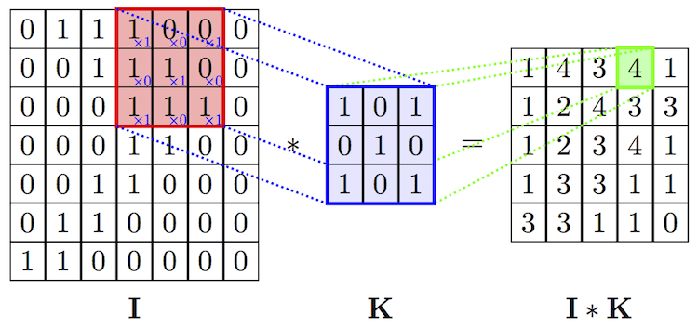
Convolution (Conv)
Step 1: Take a filter matrix K of size smaller than the input image matrix I. Conduct element-wise multiplication with the overlaid elements and then add to create a single value in the output matrix.
Step 2: Move the filter to the columns on the right based on the defined stride and repeat step 1.

Slide 11
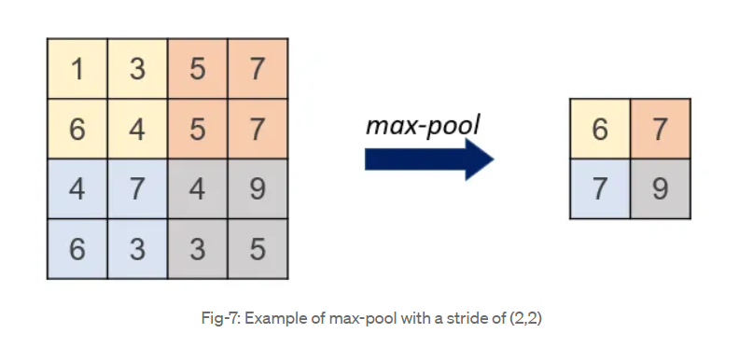
Pooling (max pool)
to reduce the number of parameters and increase the speed of computation.
operations performed in pooling
Max
average

Slide 12
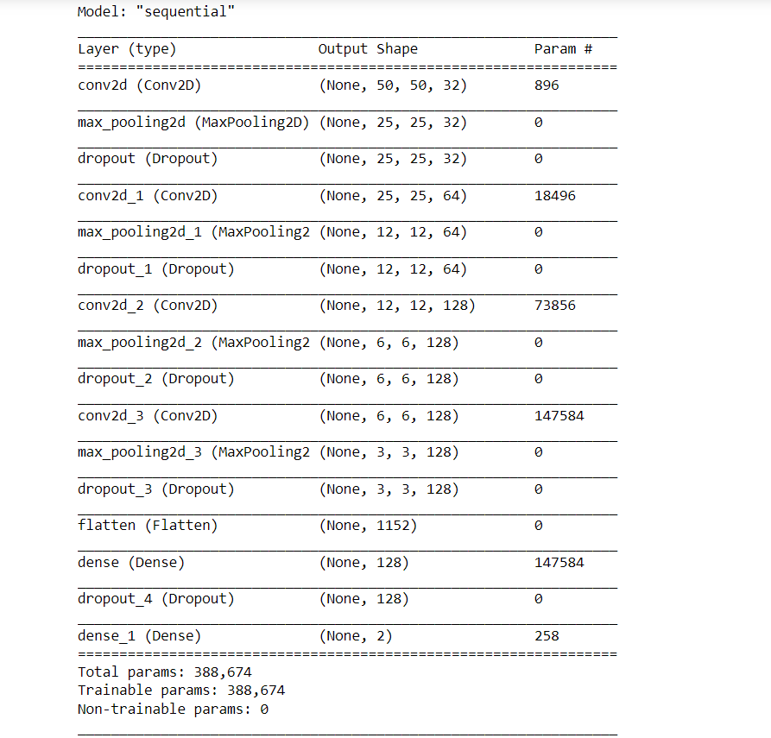
CNN Model
Electrical & Computer Engineering Department and Department of Educational Psychology

Slide 13
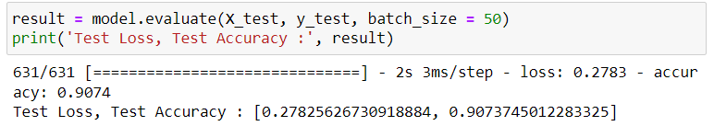
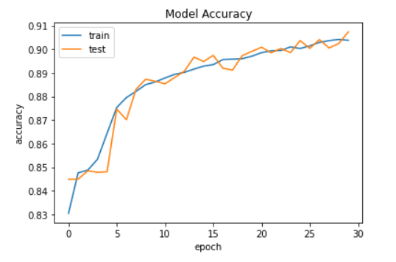
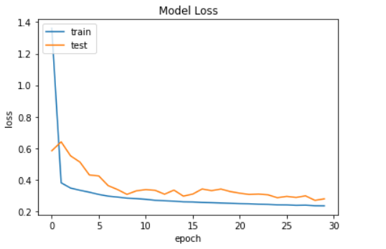
Experiments
Results Sample CNN.
Electrical & Computer Engineering Department and Department of Educational Psychology

Slide 14
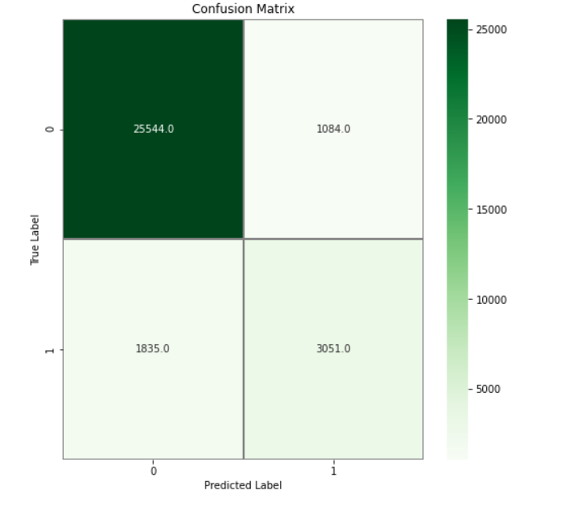
Confusion matrix for CNN
Electrical & Computer Engineering Department and Department of Educational Psychology

Slide 15
References
CIAR 2015 Grand Challenge on Breast Cancer Histology Images.
M. Macenko et al., ”A method for normalizing histology slides for quantitative analysis,” 2009 IEEE International Symposium on Biomedical Imaging: From Nano to Macro, Boston, MA, 2009.
Gao Huang, Zhuang, Liu, Laurens Van Der Maaten, Kilian Q.Weinberger, 2016. Densely Connected Convolutional Networks.
Srivastava, N., Hinton, G., Krizhevsky, A., Sutskever, I. and Salakhutdinov, R., 2014. Dropout: A simple way to prevent neural networks from overfitting. The Journal of MachineLearning Research.
Ioffe, S. and Szegedy, C., 2015. Batch normalization: Accelerating deep network training by reducing internal covariate shift. arXiv preprint arXiv:1502.03167
Electrical & Computer Engineering Department and Department of Educational Psychology

Slide 16
Thank you
Electrical & Computer Engineering Department and Department of Educational Psychology

